Slide 1
INTRO TO PROJECT MANAGEMENT
CE 4200 PROFESSIONAL ENGINEERING PRACTICE ISSUES
Spring 2022 SEMESTER
WILLIAM D. LAWSON, PE, PHD

Slide 2
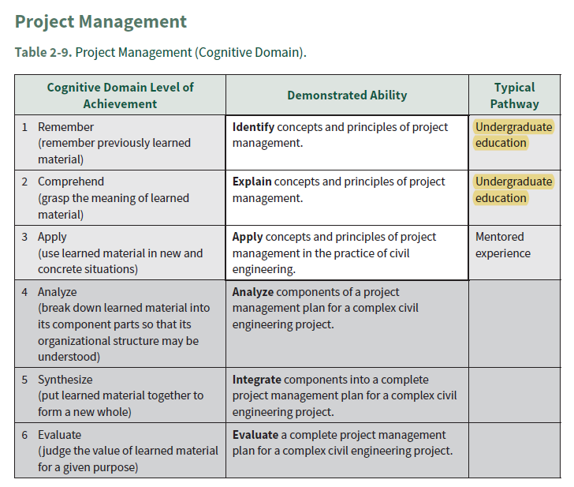

ASCE BOK3…
“PROJECT MANAGEMENT”

Slide 3

Introduction to Project Management
SOURCE: online presentation by Avneet Mathur, PMP

Slide 4

The Project Management Institute (PMI) is a global nonprofit professional organization for project management.
The PMI serves more than 2.9 million professionals including over 500,000 members in 208 countries and territories around the world, with 300 chapters and 10,000 volunteers serving local members in over 80 countries.
Its services include the development of standards, research, education, publication, networking-opportunities in local chapters, hosting conferences and training seminars, and providing accreditation in project management.

Slide 5
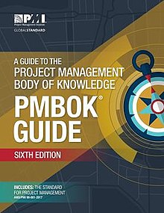
The Project Management Body of Knowledge is a set of standard terminology and guidelines (a body of knowledge) for project management.
The PMBOK Guide is intended to be a "subset of the project management body of knowledge that is generally recognized as a good practice.
The PMI produced the first Project Management Body of Knowledge (PMBOK) in 1996.

Slide 6
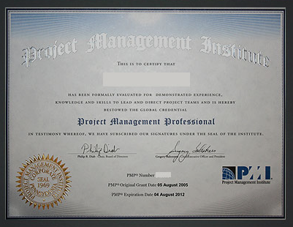
PMP
Project Management Professional
Government, commercial and other organizations employ PMP certified project managers in an attempt to improve the success rate of projects in all areas of knowledge, by applying a standardized and evolving set of project management principles as contained in PMI's PMBOK Guide.
Candidates must have completed a high school diploma or an associates degree with 60 months and 7,500 hours of project management experience, or a bachelor's degree with 36 months and 4,500 hours of project management experience.

Slide 7
What is a Project?
A project is a temporary endeavor undertaken to produce a unique product or service
Temporary – Definitive beginning and end
Unique – New undertaking, unfamiliar ground
Temporary
Unique
Characteristics of
Projects

Slide 8
Examples
Developing a new pharmaceutical compound for market
Expanding a tour guide service
Merging two organizations
Improving a business process within an organization
Acquiring and installing a new computer hardware system for use in an organization
Exploring for oil in a region
Conducting research to develop a new manufacturing process
Constructing a building

Slide 9
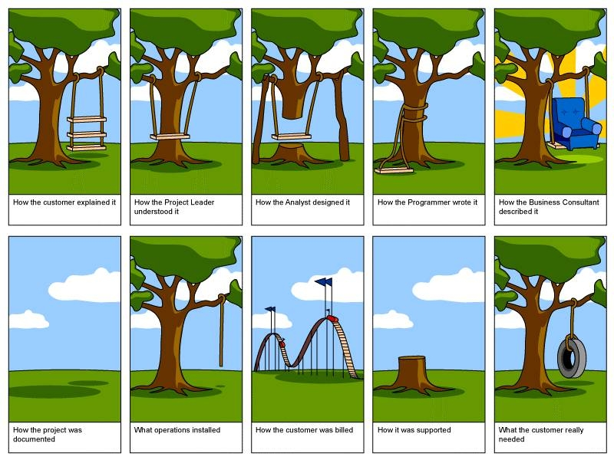


Slide 10
Deliverable
Any unique and verifiable product, result, or capability to perform a service that is required to be produced to complete a process, phase, or project.
Some examples:
Engineering report
Proposal
Design drawings
Design documents
Completed product (building, bridge, etc.)
Technical interpretation
Site investigation report

Slide 11

Project Success
Customer Requirements satisfied/exceeded
Completed within allocated time frame
Completed within allocated budget
Accepted by the customer

Slide 12

Project Failure
Scope Creep
Poor Requirements Gathering
Unrealistic planning and scheduling
Lack of resources

Slide 13
What is Project Management?
Project Management is the application of skills, knowledge, tools and techniques to meet the needs and expectations of stakeholders for a project.
The purpose of project management is prediction and prevention, NOT recognition and reaction

Slide 14
Triple Contraint
Time
Quality
Cost
Scope

Slide 15
Triple Contraint
Increased Scope = increased time + increased cost
Tight Time = increased costs + reduced scope
Tight Budget = increased time + reduced scope.

Slide 16
Role of a Project Manager
Project issues
Disseminating project information
Mitigating project risk
Quality
Managing scope
Metrics
Managing the overall work plan
Implementing standard processes
Establishing leadership skills
Setting expectations
Team building
Communicator skills
Process Responsibilities
People Responsibilities
Notes:
Process Responsibilities
The project manager normally is responsible for defining and planning the project. This results in the completion of a Project Definition and a project workplan. Once the project starts, the project manager must successfully manage and control the work, including:
Identifying, tracking managing and resolving project issues
Proactively disseminating project information to all stakeholders
Identifying, managing and mitigating project risk
Ensuring that the solution is of acceptable quality
Proactively managing scope to ensure that only what was agreed to is delivered, unless changes are approved through scope management
Defining and collecting metrics to give a sense for how the project is progressing and whether the deliverables produced are acceptable
Managing the overall workplan to ensure work is assigned and completed on time and within budget
To manage the project management processes, a person should be well organized, have great follow-up skills, be process oriented, be able to multi-task, have a logical thought process, be able to determine root causes, have good analytical ability, be a good estimator and budget manager, and have good self-discipline.
People Responsibilities
In addition to process skills, a project manager must have good people management skills. This includes:
Having the discipline and general management skills to make sure that people follow the standard processes and procedures
Establishing leadership skills to get the team to willingly follow your direction. Leadership is about communicating a vision and getting the team to accept it and strive to get there with you.
Setting reasonable, challenging and clear expectations for people, and holding them accountable for meeting the expectations. This includes providing good performance feedback to team members
Team building skills so that the people work together well, and feel motivated to work hard for the sake of the project and their other team members. The larger your team and the longer the project, the more important it is to have good team-building skills.
Proactive verbal and written communicator skills, including good, active listening skills.
Multiple Roles
Depending on the size and complexity of the project, the project manager may take on other responsibilities in addition to managing the work. For instance, the project manager may assist with gathering business requirements. Or they may help design a database management system or they may write some of the project documentation. Project management is a particular role that a person fills, even if the person who is the project manager is working in other roles as well.

Slide 17

Key Areas of Project Management
Scope Management
Schedule Management
Cost Management
Quality Management
Resource Management
Communications Management
Risk Management
Change Control Management
Notes:
SCOPE MANAGEMENT – Ensuring all the appropriate work within the project scope is completed and only the work within scope is being conducted
TIME MANAGEMENT – Schedule Management
COST MANAGEMENT – How costs are controlled and incurred costs are paid
QUALITY MANAGEMENT – Quality Assurance Plan – How quality control is measured and satisfied
HUMAN RESOURCE MANAGEMENT – Development of the project team, reporting structure, resource capacity
COMMUNICATIONS MANAGEMENT – How project communications will be handled to ensure all project stakeholders are informed
RISK MANAGEMENT – Risk Management plan to have all project stakeholders in agreement on how project risks will be handled (aversion, mitigation or assumption)
PROCUREMENT MANAGEMENT – Procurement process, contract processes
INTEGRATION MANAGEMENT – Integration of all areas of project management to develop a cohesive project plan

Slide 18




Scope Management
Project Scope Management is the process to ensure that the project is inclusive of all the work required, and only the work required, for successful completion.
Primarily it is the definition and control of what IS and IS NOT included in the project.
Notes:
This component is used to communicate
How the scope was defined
How the project scope will be managed
Who will manage the scope (e.g., PM, QA)
Change Control

Slide 19
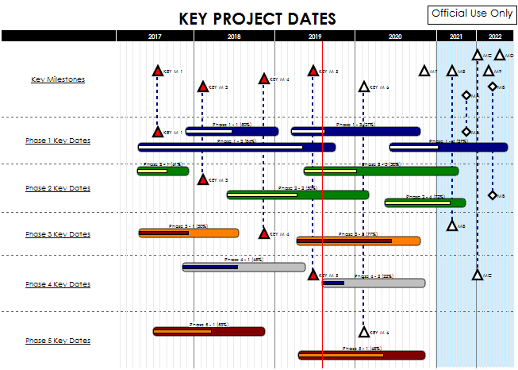
Schedule Management
Project Schedule: an output of a schedule model that presents linked activities with planned dates, durations, milestones, and resources.
Typically identified throughout the project and logged and tracked through resolution.
Notes:
Issues not easily resolved are escalated for resolution.
Issues are typically identified throughout the project and logged and tracked through resolution.
In this section of the plan the following processes are depicted:
Where issues will be maintained and tracked
The process for updating issues regularly
The escalation process
The vehicle by which team members can access documented issues
Issue… already impacting the cost, time or quality
Risk… POTENTIAL negative impact to project

Slide 20

Exercise 15.1 Explore the underpinnings of project scheduling
THINK
Identify a specific project you are personally familiar with (say, either at work or here at University – associated with your education)
What is the project schedule? How is the project schedule communicated?
Why do you think “owners” or “supervisors” set project schedules the way they do?

Slide 21
Exercise 15.1, cont’d. Explore the underpinnings of project scheduling
PAIR, SHARE…
Meet the people around you (3 to 4 persons) and discuss your ideas about project schedules
Consider the possible inputs that influence setting schedules for engineering work. Come up with a list
Be prepared to share your answers (5 minutes).

Slide 22
Issue Management
Issues are restraints to accomplishing the deliverables of the project.
Issues are typically identified throughout the project and logged and tracked through resolution.
In this section of the plan the following processes are depicted:
Where issues will be maintained and tracked
The process for updating issues regularly
The escalation process
The vehicle by which team members can access documented issues
Notes:
Issues not easily resolved are escalated for resolution.

Slide 23
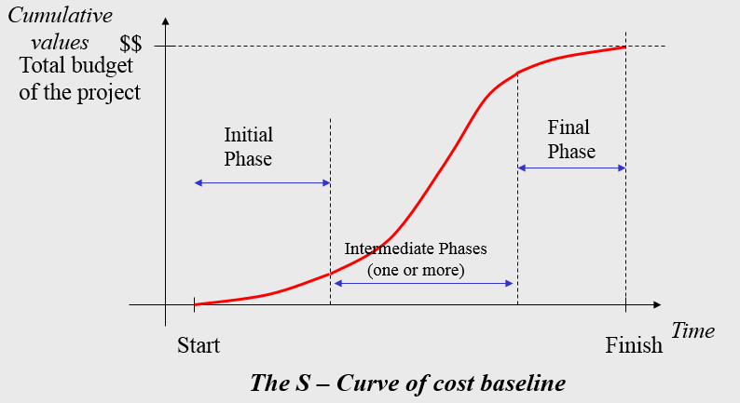
Cost Management
This process is required to ensure the project is completed within the approved budget and includes:
Resource Planning - The physical resources required (people, equipment, materials) and what quantities are necessary for the project
Budget
Budget estimates
Baseline estimates
Project Actuals
Notes:
Resource Planning - Full Time Employees, Professional Services, Cost, and Contingency

Slide 24

Quality Management
Quality Management is the process that insure the project will meet the needs
“the degree to which a set of inherent characteristics fulfills requirements” - PMBOK6
“conformance to requirements” - Crosby
“fitness for use” - Juran
“the totality of characteristics of an
entity that bear on its ability to
satisfy stated and implied need’ - ISO 8402:1994
Notes:
What is Quality - conformance to requirements’ - Crosby
‘fitness for use’ - Juran
‘the totality of characteristics of an entity that bear on its ability to satisfy stated and implied need’ - ISO 8402:1994
Customer-Based -> Fitness for use, meeting customer expectations.
Manufacturing-Based -> Conforming to design, specifications, or requirements. Having no defects.
Product-Based -> The product has something that other similar products do not that adds value.
Value-Based -> The product is the best combination of price and features. 5. Transcendent It is not clear what it is, but it is something good...
via:
Quality Planning, Quality Assurance, and Quality Control
Clearly Defined Quality Performance Standards
How those Quality and Performance Standards are measured and satisfied
How Testing and Quality Assurance Processes will ensure standards are satisfied
Continuous ongoing quality control

Slide 25
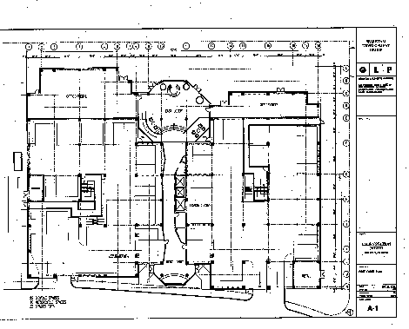
Communications Management
This process is necessary to ensure timely and appropriate generation, collection, dissemination, and storage of project information using:
Communications planning
Information Distribution
Performance Reporting
Define the schedule for the Project Meetings (Team, OSC, ESC), Status Meetings and Issues Meetings to be implemented
Notes:
Communications planning: Determining the needs (who needs what information, when they need it, and how it will be delivered)
Information Distribution: Defining who and how information will flow to the project stakeholders and the frequency
Performance Reporting: Providing project performance updates via status reporting.

Slide 26
Risk Management
Risk: An uncertain event or condition that, if it occurs, has a positive or negative effect on one or more project objectives.
Risk identification and mitigation strategy
When\if new risks arise
Risk update and tracking

Slide 27


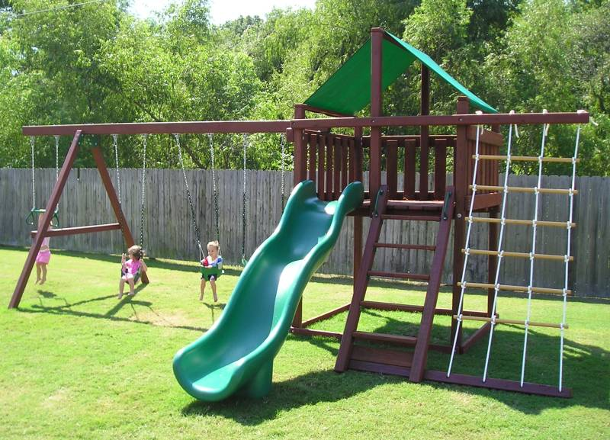
Change Control Management
Define how changes to the project scope will be executed
Scope Change
Technical Specification Changes
Schedule changes
All changes require collaboration and buy in via the project sponsor’s signature
prior to implementation of the changes
Notes:
Formal change control is required for all of the following
Scope Change
Schedule changes
Technical Specification Changes
Training Changes
All changes require collaboration and buy in via the project sponsor’s signature prior to implementation of the changes

Slide 28
PHASES OF A PROJECT

Slide 29
Project Life Cycle
Initiation Phase
Definition Phase
Planning Phase
Implementation Phase
Deployment Phase
Closing Phase

Slide 30

Initiation Phase
Define the need
Return on Investment Analysis
Make or Buy Decision
Budget Development

Slide 31

Definition Phase
Determine goals, scope and project constraints
Identify members and their roles
Define communication channels, methods, frequency and content
Risk management planning

Slide 32
Planning Phase
Resource Planning
Work Breakdown Structure
Project Schedule Development
Quality Assurance Plan

Slide 33

Work Breakdown Structure (WBS)
A hierarchical decomposition of the total scope of work to be carried out by the project team to accomplish the project objectives and create the required deliverables.

Slide 34
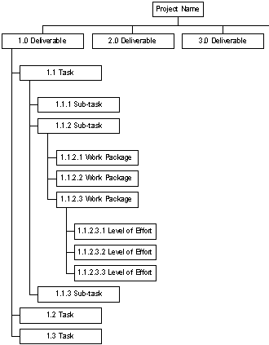
Work Breakdown Structure
For defining and organizing the total scope of a project
First two levels - define a set of planned outcomes that collectively and exclusively represent 100% of the project scope.
Subsequent levels - represent 100% of the scope of their parent node

Slide 35
Implementation Phase
Execute project plan and accomplish project goals
Training Plan
System Build
Quality Assurance

Slide 36
Deployment Phase
User Training
Production Review
Start Using

Slide 37
Closing Phase
Contractual Closeout
Post Production Transition
Lessons Learned

Slide 38
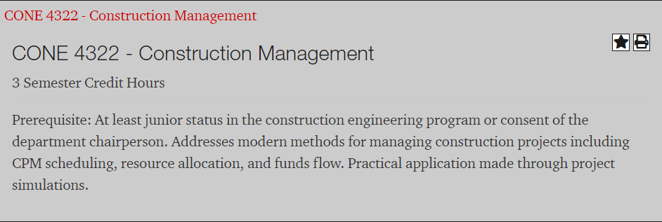
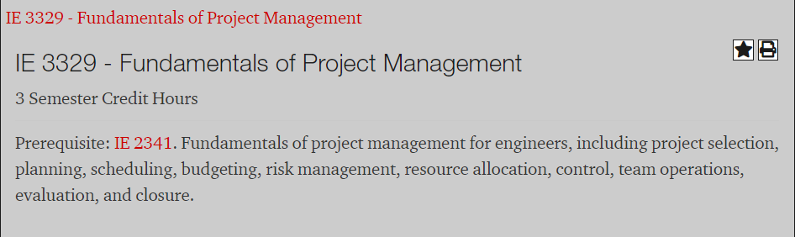
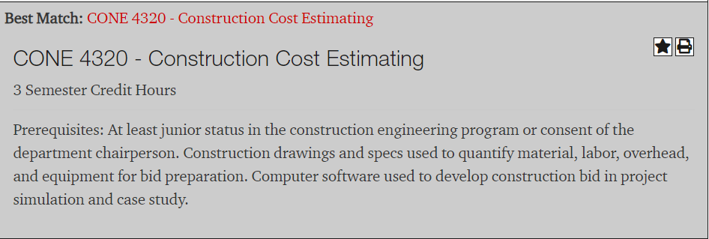
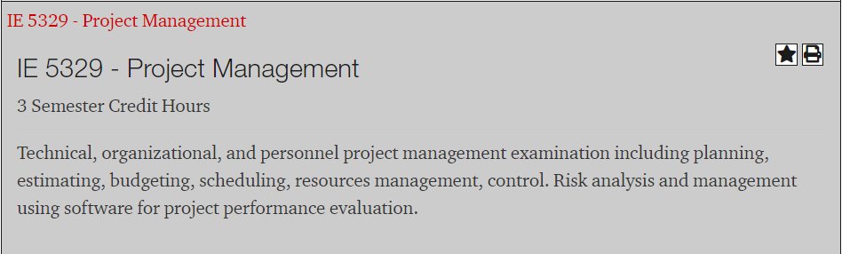
Some PM Courses at TTU If you’re looking for a technical elective…

Slide 39
SUMMARY
A project is a temporary endeavor undertaken to produce a unique product or service
It is common for business activities to be “project based”
Projects can go well or they can go poorly
The triple constraints on any project are scope, cost and time… assumes acceptable quality
Project management is the application of skills, knowledge, tools and techniques to project activities to meet the project requirements

Slide 40
THANK YOU.

